Slide 1
Fibrinolysis_Regression
Kamal Mandava

Slide 2
Table of Contents
Introduction
Motivation
Research Questions
Dataset Description
Results
Global F-Test and Model Summary
Regression Equation
Interpretation of Individual Coefficients
Residual Analysis Summary
Discussion
Main Findings and Concluding Remarks
Limitations of the Analysis
What Would Be Done Differently
Future Research Directions

Slide 3
library(car)
## Loading required package: carData
library(MASS) library(leaps) library(psych)
## Warning: package 'psych' was built under R version 4.5.2
## ## Attaching package: 'psych'
## The following object is masked from 'package:car': ## ## logit
library(corrplot)
## Warning: package 'corrplot' was built under R version 4.5.2
## corrplot 0.95 loaded

Slide 4
Introduction

Slide 5
Motivation
Fibrinolysis is a process that involves the breakdown of blood clots, which is essential for maintaining proper blood flow. Understanding the relationship between various biochemical parameters and the rate of fibrinolysis has significant implications for both clinical medicine and pharmaceutical research. By modeling how different kinetic constants and binding affinities influence the median lysis time, we can gain insights into the underlying mechanisms of clot dissolution and potentially identify key factors that could be targeted for therapeutic interventions.

Slide 6
Research Questions
This analysis seeks to answer several important questions:
Which biochemical parameters (kinetic constants and binding affinities) are most predictive of median lysis time?
Can we develop a reliable statistical model to predict fibrinolysis rates based on these chemical affinity variables?
How do transformations of the variables affect the model’s predictive power and interpretability?
What is the relative importance of different parameters in determining fibrinolysis outcomes?

Slide 7
Dataset Description
The dataset contains measurements from 42 experimental observations, each with 9 independent variables representing various kinetic constants and binding affinities related to the fibrinolysis process. These include parameters such as the rate constant for tissue plasminogen activator (tPA) binding, plasminogen activation rates, dissociation constants for various protein complexes, and the snap proportion. The dependent variable of interest is the median lysis time, which represents the time taken for clot dissolution under specific experimental conditions.

Slide 8
Results

Slide 9
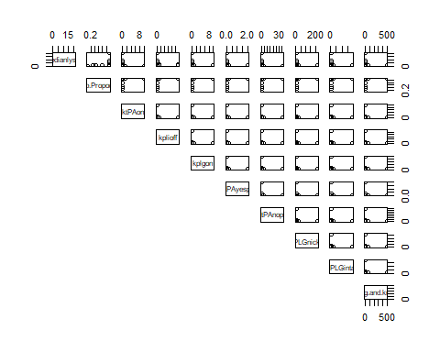
ReadCSV
lysis <- read.csv("target.csv")
Summary Statistics
summary(lysis)
## Snap.Proportion ktPAon kplioff kplgon ## Min. :0.1250 Min. : 0.0010 Min. : 0.576 Min. : 0.0010 ## 1st Qu.:0.6667 1st Qu.: 0.1000 1st Qu.: 57.600 1st Qu.: 0.1000 ## Median :0.6667 Median : 0.1000 Median : 57.600 Median : 0.1000 ## Mean :0.6319 Mean : 0.3409 Mean : 348.645 Mean : 0.3526 ## 3rd Qu.:0.6667 3rd Qu.: 0.1000 3rd Qu.: 57.600 3rd Qu.: 0.1000 ## Max. :0.6667 Max. :10.0000 Max. :5760.000 Max. :10.0000 ## KdtPAyesplg KdtPAnoplg KdPLGnicked KdPLGintact ## Min. :0.00020 Min. : 0.0036 Min. : 0.022 Min. : 0.38 ## 1st Qu.:0.02000 1st Qu.: 0.3600 1st Qu.: 2.200 1st Qu.: 38.00 ## Median :0.02000 Median : 0.3600 Median : 2.200 Median : 38.00 ## Mean :0.07053 Mean : 1.2695 Mean : 7.758 Mean : 134.00 ## 3rd Qu.:0.02000 3rd Qu.: 0.3600 3rd Qu.: 2.200 3rd Qu.: 38.00 ## Max. :2.00000 Max. :36.0000 Max. :220.000 Max. :3800.00 ## kdeg.and.kncat medianlysis ## Min. : 0.05 Min. : 0.2645 ## 1st Qu.: 5.00 1st Qu.: 0.4538 ## Median : 5.00 Median : 0.5399 ## Mean : 17.63 Mean : 1.6513 ## 3rd Qu.: 5.00 3rd Qu.: 1.6116 ## Max. :500.00 Max. :20.5649
sapply(lysis, sd)
## Snap.Proportion ktPAon kplioff kplgon KdtPAyesplg ## 0.1165935 1.5337694 1229.9751663 1.5314357 0.3062871 ## KdtPAnoplg KdPLGnicked KdPLGintact kdeg.and.kncat medianlysis ## 5.5131685 33.6915854 581.9455666 76.5717851 3.3365496
describe(lysis)
## vars n mean sd median trimmed mad min max range ## Snap.Proportion 1 42 0.63 0.12 0.67 0.67 0.00 0.12 0.67 0.54 ## ktPAon 2 42 0.34 1.53 0.10 0.09 0.00 0.00 10.00 10.00 ## kplioff 3 42 348.64 1229.98 57.60 57.60 0.00 0.58 5760.00 5759.42 ## kplgon 4 42 0.35 1.53 0.10 0.10 0.00 0.00 10.00 10.00 ## KdtPAyesplg 5 42 0.07 0.31 0.02 0.02 0.00 0.00 2.00 2.00 ## KdtPAnoplg 6 42 1.27 5.51 0.36 0.36 0.00 0.00 36.00 36.00 ## KdPLGnicked 7 42 7.76 33.69 2.20 2.20 0.00 0.02 220.00 219.98 ## KdPLGintact 8 42 134.00 581.95 38.00 38.00 0.00 0.38 3800.00 3799.62 ## kdeg.and.kncat 9 42 17.63 76.57 5.00 5.00 0.00 0.05 500.00 499.95 ## medianlysis 10 42 1.65 3.34 0.54 0.92 0.28 0.26 20.56 20.30 ## skew kurtosis se ## Snap.Proportion -3.22 9.36 0.02 ## ktPAon 5.94 34.45 0.24 ## kplioff 4.04 14.84 189.79 ## kplgon 5.95 34.50 0.24 ## KdtPAyesplg 5.95 34.50 0.05 ## KdtPAnoplg 5.95 34.50 0.85 ## KdPLGnicked 5.95 34.50 5.20 ## KdPLGintact 5.95 34.50 89.80 ## kdeg.and.kncat 5.95 34.50 11.82 ## medianlysis 4.50 21.92 0.51
pairs(lysis[, c("medianlysis", "Snap.Proportion", "ktPAon", "kplioff", "kplgon", "KdtPAyesplg", "KdtPAnoplg", "KdPLGnicked", "KdPLGintact", "kdeg.and.kncat")], lower.panel=NULL)

Slide 10
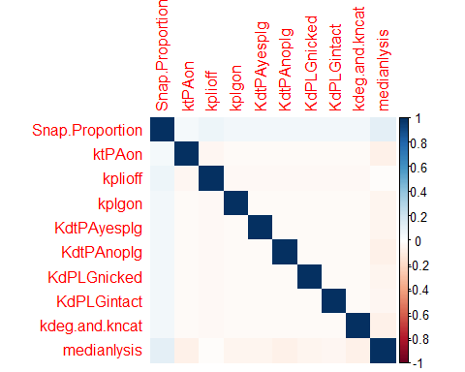
Figure 1: Pairwise scatterplots of all variables. This plot matrix provides a visual overview of the relationships between variables, helping to identify potential linear association before formal modeling. Visually we can see that there is no linear relationship present between median lysis and other variables which means that we might need to transform the variables necessarily.
Fitting the Original Model
Org_model <- lm(medianlysis ~., data = lysis) summary(Org_model)
## ## Call: ## lm(formula = medianlysis ~ ., data = lysis) ## ## Residuals: ## Min 1Q Median 3Q Max ## -1.8079 -1.6196 -0.5921 0.2176 18.3605 ## ## Coefficients: ## Estimate Std. Error t value Pr(>|t|) ## (Intercept) -0.6004791 3.1540195 -0.190 0.850 ## Snap.Proportion 4.3878629 4.9810891 0.881 0.385 ## ktPAon -0.2165594 0.3752938 -0.577 0.568 ## kplioff -0.0001510 0.0004705 -0.321 0.750 ## kplgon -0.1764185 0.3758938 -0.469 0.642 ## KdtPAyesplg -0.9089443 1.8794688 -0.484 0.632 ## KdtPAnoplg -0.0580584 0.1044149 -0.556 0.582 ## KdPLGnicked -0.0080217 0.0170861 -0.469 0.642 ## KdPLGintact -0.0004098 0.0009892 -0.414 0.681 ## kdeg.and.kncat -0.0043838 0.0075179 -0.583 0.564 ## ## Residual standard error: 3.664 on 32 degrees of freedom ## Multiple R-squared: 0.05877, Adjusted R-squared: -0.2059 ## F-statistic: 0.222 on 9 and 32 DF, p-value: 0.989
Global $F$-test:
$H_{0}:β_{1}=β_{2}=.....=0$
$H_{1}:$ At least one $β_{i}≠0$
$F=0.222$
$p=0.989>0.05$
Fail to Reject $H_{0}$, insufficient evidence to conclude the model is useful
This model is statistically insignificant
Correlation
cor(lysis)
## Snap.Proportion ktPAon kplioff kplgon KdtPAyesplg ## Snap.Proportion 1.00000000 0.04802077 0.07235905 0.05044730 0.05044730 ## ktPAon 0.04802077 1.00000000 -0.04588820 -0.02653830 -0.02653830 ## kplioff 0.07235905 -0.04588820 1.00000000 -0.03998866 -0.03998866 ## kplgon 0.05044730 -0.02653830 -0.03998866 1.00000000 -0.02787931 ## KdtPAyesplg 0.05044730 -0.02653830 -0.03998866 -0.02787931 1.00000000 ## KdtPAnoplg 0.05044730 -0.02653830 -0.03998866 -0.02787931 -0.02787931 ## KdPLGnicked 0.05044730 -0.02653830 -0.03998866 -0.02787931 -0.02787931 ## KdPLGintact 0.05044730 -0.02653830 -0.03998866 -0.02787931 -0.02787931 ## kdeg.and.kncat 0.05044730 -0.02653830 -0.03998866 -0.02787931 -0.02787931 ## medianlysis 0.11862230 -0.07600711 -0.01946428 -0.05631483 -0.05884849 ## KdtPAnoplg KdPLGnicked KdPLGintact kdeg.and.kncat medianlysis ## Snap.Proportion 0.05044730 0.05044730 0.05044730 0.05044730 0.11862230 ## ktPAon -0.02653830 -0.02653830 -0.02653830 -0.02653830 -0.07600711 ## kplioff -0.03998866 -0.03998866 -0.03998866 -0.03998866 -0.01946428 ## kplgon -0.02787931 -0.02787931 -0.02787931 -0.02787931 -0.05631483 ## KdtPAyesplg -0.02787931 -0.02787931 -0.02787931 -0.02787931 -0.05884849 ## KdtPAnoplg 1.00000000 -0.02787931 -0.02787931 -0.02787931 -0.07169104 ## KdPLGnicked -0.02787931 1.00000000 -0.02787931 -0.02787931 -0.05634297 ## KdPLGintact -0.02787931 -0.02787931 1.00000000 -0.02787931 -0.04654581 ## kdeg.and.kncat -0.02787931 -0.02787931 -0.02787931 1.00000000 -0.07649436 ## medianlysis -0.07169104 -0.05634297 -0.04654581 -0.07649436 1.00000000
corrplot(cor(lysis), method = "color", t1.cex=0.7)
## Warning in text.default(pos.xlabel[, 1], pos.xlabel[, 2], newcolnames, srt = ## tl.srt, : "t1.cex" is not a graphical parameter
## Warning in text.default(pos.ylabel[, 1], pos.ylabel[, 2], newrownames, col = ## tl.col, : "t1.cex" is not a graphical parameter
## Warning in title(title, ...): "t1.cex" is not a graphical parameter

Slide 11
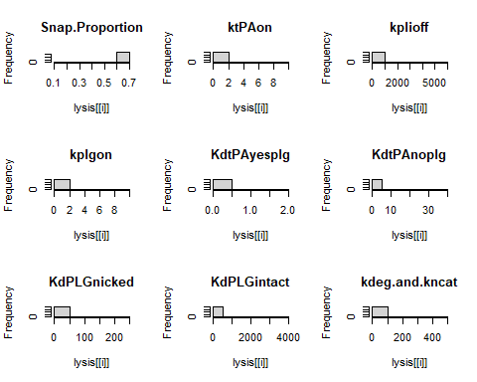
Figure 2: Correlation matrix visualization. The color coded correlation plot reveals the strength and direction of linear relationships between variables. Strong correlations (close to ±1) appear in darker colors, while weak correlations appear lighter. This helps identify potential multicollinearity issues that could affect regression modeling, which in this case there is no correlation relationship among the independent variables.
Diagnostics
par(mfrow=c(3,3)) for(i in 1:9) hist(lysis[[i]], main=names(lysis)[i])

Slide 12
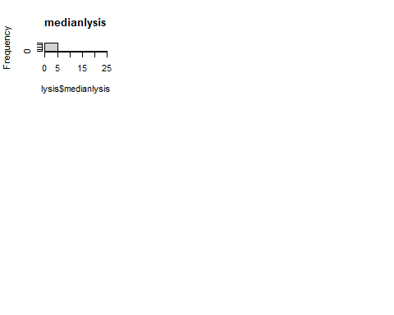
hist(lysis$medianlysis, main="medianlysis")

Slide 13
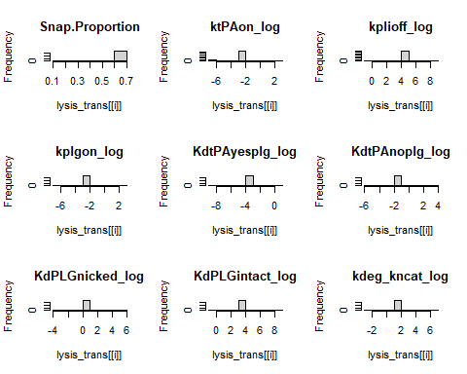
Figure 3: Distribution histograms for all variables. These histograms reveal the distributional properties of each variable, including skewness, potential outliers, and whether transformations might be necessary to meet normality assumptions for regression analysis. Log transformation is used to address right skewness and improve linearity, Log transformation compresses large values more than small ones, reducing the impact of extreme values and making the distribution more symmetric.
Actions to tackle skewness and make the normality assumption valid
# Snap.Proportion is a proportion (0–1), not a rate constant or concentration. It may already be bounded and less skewed, or have a different distribution, so log transformation is unnecessary. lysis$ktPAon_log <- log(lysis$ktPAon) lysis$kplioff_log <- log(lysis$kplioff) lysis$kplgon_log <- log(lysis$kplgon) lysis$KdtPAyesplg_log <- log(lysis$KdtPAyesplg) lysis$KdtPAnoplg_log <- log(lysis$KdtPAnoplg) lysis$KdPLGnicked_log <- log(lysis$KdPLGnicked) lysis$KdPLGintact_log <- log(lysis$KdPLGintact) lysis$kdeg_kncat_log <- log(lysis$kdeg.and.kncat) # Keep transformed predictors + original Snap.Proportion lysis_trans <- data.frame( Snap.Proportion = lysis$Snap.Proportion, ktPAon_log = lysis$ktPAon_log, kplioff_log = lysis$kplioff_log, kplgon_log = lysis$kplgon_log, KdtPAyesplg_log = lysis$KdtPAyesplg_log, KdtPAnoplg_log = lysis$KdtPAnoplg_log, KdPLGnicked_log = lysis$KdPLGnicked_log, KdPLGintact_log = lysis$KdPLGintact_log, kdeg_kncat_log = lysis$kdeg_kncat_log, medianlysis = lysis$medianlysis ) # Quick check summary(lysis_trans)
## Snap.Proportion ktPAon_log kplioff_log kplgon_log ## Min. :0.1250 Min. :-6.908 Min. :-0.5516 Min. :-6.908 ## 1st Qu.:0.6667 1st Qu.:-2.303 1st Qu.: 4.0535 1st Qu.:-2.303 ## Median :0.6667 Median :-2.303 Median : 4.0535 Median :-2.303 ## Mean :0.6319 Mean :-2.851 Mean : 4.0535 Mean :-2.303 ## 3rd Qu.:0.6667 3rd Qu.:-2.303 3rd Qu.: 4.0535 3rd Qu.:-2.303 ## Max. :0.6667 Max. : 2.303 Max. : 8.6587 Max. : 2.303 ## KdtPAyesplg_log KdtPAnoplg_log KdPLGnicked_log KdPLGintact_log ## Min. :-8.5172 Min. :-5.627 Min. :-3.8167 Min. :-0.9676 ## 1st Qu.:-3.9120 1st Qu.:-1.022 1st Qu.: 0.7885 1st Qu.: 3.6376 ## Median :-3.9120 Median :-1.022 Median : 0.7885 Median : 3.6376 ## Mean :-3.9120 Mean :-1.022 Mean : 0.7885 Mean : 3.6376 ## 3rd Qu.:-3.9120 3rd Qu.:-1.022 3rd Qu.: 0.7885 3rd Qu.: 3.6376 ## Max. : 0.6931 Max. : 3.584 Max. : 5.3936 Max. : 8.2428 ## kdeg_kncat_log medianlysis ## Min. :-2.996 Min. : 0.2645 ## 1st Qu.: 1.609 1st Qu.: 0.4538 ## Median : 1.609 Median : 0.5399 ## Mean : 1.609 Mean : 1.6513 ## 3rd Qu.: 1.609 3rd Qu.: 1.6116 ## Max. : 6.215 Max. :20.5649
par(mfrow=c(3,3)) for(i in 1:9) hist(lysis_trans[[i]], main=names(lysis_trans)[i])

Slide 14
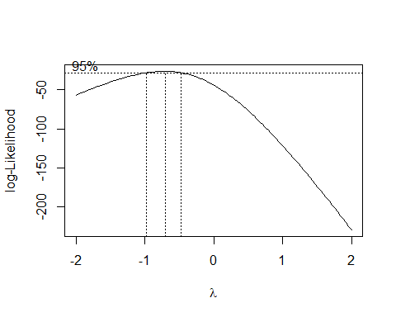
So based on this transformation I can interpret that:
There are concentrated bars after transformation, this is mainly due to the fact that: 1) Limited distinct values in the original data. 2) Small sample size (n = 42)
I don’t necessarily consider it to be a problem. For regression You don’t need perfectly normal distributions for predictors. The thing that matters the most is the relationships are more linear and variance is more stable. The concentration in the center is often better than the original extreme right skew.
Hence the log transformation successfully addressed the extreme right skewness observed in most of the kinetic parameters.
Model Fitting after Log Transformation
#Model Fitting lysis_lm <- lm(medianlysis ~., data = lysis_trans) summary(lysis_lm)
## ## Call: ## lm(formula = medianlysis ~ ., data = lysis_trans) ## ## Residuals: ## Min 1Q Median 3Q Max ## -3.4956 -1.0023 -0.7485 0.0317 10.5510 ## ## Coefficients: ## Estimate Std. Error t value Pr(>|t|) ## (Intercept) 3.513138 3.375143 1.041 0.3057 ## Snap.Proportion 2.847863 3.544619 0.803 0.4277 ## ktPAon_log -0.380244 0.218683 -1.739 0.0917 . ## kplioff_log -0.476968 0.255970 -1.863 0.0716 . ## kplgon_log 0.013815 0.361997 0.038 0.9698 ## KdtPAyesplg_log -0.005168 0.361997 -0.014 0.9887 ## KdtPAnoplg_log -0.241107 0.361997 -0.666 0.5102 ## KdPLGnicked_log -0.004321 0.361997 -0.012 0.9905 ## KdPLGintact_log -0.022688 0.361997 -0.063 0.9504 ## kdeg_kncat_log -1.839663 0.361997 -5.082 1.57e-05 *** ## --- ## Signif. codes: 0 '***' 0.001 '**' 0.01 '*' 0.05 '.' 0.1 ' ' 1 ## ## Residual standard error: 2.636 on 32 degrees of freedom ## Multiple R-squared: 0.5129, Adjusted R-squared: 0.3759 ## F-statistic: 3.744 on 9 and 32 DF, p-value: 0.002637
The initial model with all predictors and the untransformed response variable performed poorly. The global F-test p-value of 0.989 indicates that the model as a whole is not statistically significant at any conventional level ($α$ = 0.05). This means we cannot reject the null hypothesis that all regression coefficients are zero. These results clearly indicate that transformations or alternative modeling approaches are necessary.
After the Logarithmic Transformation of independent variables:
Global $F$-test:
$H_{0}:β_{1}=β_{2}=......=0$
$H_{1}:$ At least one $β_{i}≠0$
$F=3.744$
$p=0.002637<0.05$
Reject $H_{0}$, sufficient evidence to conclude the model is useful
The Transformed regression model performed well and is statistically significant with an Adjusted R squared of 0.3759, which means that the regression model explains 37.59% of variance in median lysis. This is far better than our original model, but I would like to improve the adjusted R squared since only ~37% of variance is being explained.
boxcox transformation
boxcox(lysis_lm)

Slide 15
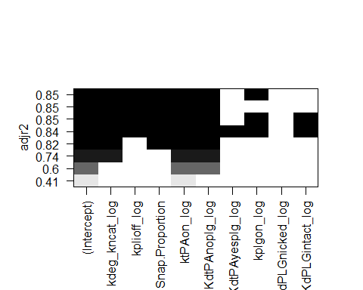
The Box-Cox transformation analysis suggests an optimal lambda value close to -1, which corresponds to the reciprocal transformation (1/Y). This indicates that the response variable (median lysis) also requires transformation to better meet the assumptions of linear regression.
Reciprocal Transformation of Y
lysis_trans$medianlysis <- 1/(lysis_trans$medianlysis) # this would push the inverse of medianlysis to medianlysis variable - the name remains unchanged but the transformation happens # refitting the model with transformed data trans_lysis_lm <- lm(medianlysis ~., data = lysis_trans) summary(trans_lysis_lm)
## ## Call: ## lm(formula = medianlysis ~ ., data = lysis_trans) ## ## Residuals: ## Min 1Q Median 3Q Max ## -1.07513 -0.12941 0.02219 0.20119 0.75753 ## ## Coefficients: ## Estimate Std. Error t value Pr(>|t|) ## (Intercept) 3.47635 0.54362 6.395 3.48e-07 *** ## Snap.Proportion -2.47596 0.57092 -4.337 0.000135 *** ## ktPAon_log 0.34749 0.03522 9.865 3.15e-11 *** ## kplioff_log 0.11895 0.04123 2.885 0.006948 ** ## kplgon_log -0.06423 0.05831 -1.102 0.278858 ## KdtPAyesplg_log 0.01949 0.05831 0.334 0.740365 ## KdtPAnoplg_log 0.41269 0.05831 7.078 4.99e-08 *** ## KdPLGnicked_log 0.01389 0.05831 0.238 0.813157 ## KdPLGintact_log 0.02104 0.05831 0.361 0.720549 ## kdeg_kncat_log 0.34842 0.05831 5.976 1.16e-06 *** ## --- ## Signif. codes: 0 '***' 0.001 '**' 0.01 '*' 0.05 '.' 0.1 ' ' 1 ## ## Residual standard error: 0.4245 on 32 degrees of freedom ## Multiple R-squared: 0.8732, Adjusted R-squared: 0.8375 ## F-statistic: 24.48 on 9 and 32 DF, p-value: 6.366e-12
After applying the reciprocal transformation to the dependent variable, the model performance improved substantially. This suggests that the model with all predictors does have some predictive power. The adjusted R-squared increased to 0.8375, meaning the model now explains approximately 83.75% of the variance in the transformed median lysis time. While this is a significant improvement from the initial original model, i would like to take a step further and perform analysis on which predictors best explain the variance in median lysis. Also the model still indicates that a substantial portion of the variability remains unexplained. This is mainly due to the experimental data that has been obtained. The experimental data had observations that have been scaled 10x times for each experiments which might have been marked as potential outliers.
Further Analysis
1) VIF
# Checking for multi-collinearity vif(trans_lysis_lm) # No multi-collinearity present all are less than 10 (cut-off)
## Snap.Proportion ktPAon_log kplioff_log kplgon_log KdtPAyesplg_log ## 1.007932 1.007932 1.000000 1.000000 1.000000 ## KdtPAnoplg_log KdPLGnicked_log KdPLGintact_log kdeg_kncat_log ## 1.000000 1.000000 1.000000 1.000000
The variance inflation factors (VIFs) for all predictors are below the commonly used threshold of 10, indicating that multi-collinearity is not a serious concern in this model. This is an important finding because high multi-collinearity can make coefficient estimates unstable and difficult to interpret. The fact that all VIFs are reasonable suggests that each predictor provides somewhat unique information about the response variable.
2) Variable screening
fwd <- lm(medianlysis ~ 1, data = lysis_trans) out_fwd <- step(fwd, scope = ~ Snap.Proportion + ktPAon_log + kplioff_log + kplgon_log + KdtPAyesplg_log + KdtPAnoplg_log +KdPLGnicked_log+ KdPLGintact_log+kdeg_kncat_log , direction = "forward")
## Start: AIC=5.35 ## medianlysis ~ 1 ## ## Df Sum of Sq RSS AIC ## + ktPAon_log 1 19.0872 26.396 -15.5064 ## + KdtPAnoplg_log 1 9.0297 36.454 -1.9480 ## + kdeg_kncat_log 1 6.4363 39.047 0.9385 ## + Snap.Proportion 1 4.9349 40.549 2.5231 ## <none> 45.484 5.3467 ## + kplioff_log 1 1.5003 43.983 5.9379 ## + kplgon_log 1 0.2187 45.265 7.1443 ## + KdPLGintact_log 1 0.0235 45.460 7.3250 ## + KdtPAyesplg_log 1 0.0201 45.464 7.3281 ## + KdPLGnicked_log 1 0.0102 45.473 7.3373 ## ## Step: AIC=-15.51 ## medianlysis ~ ktPAon_log ## ## Df Sum of Sq RSS AIC ## + KdtPAnoplg_log 1 9.0297 17.367 -31.091 ## + kdeg_kncat_log 1 6.4363 19.960 -25.245 ## + Snap.Proportion 1 3.3899 23.007 -19.279 ## + kplioff_log 1 1.5003 24.896 -15.964 ## <none> 26.396 -15.506 ## + kplgon_log 1 0.2187 26.178 -13.856 ## + KdPLGintact_log 1 0.0235 26.373 -13.544 ## + KdtPAyesplg_log 1 0.0201 26.376 -13.539 ## + KdPLGnicked_log 1 0.0102 26.386 -13.523 ## ## Step: AIC=-31.09 ## medianlysis ~ ktPAon_log + KdtPAnoplg_log ## ## Df Sum of Sq RSS AIC ## + kdeg_kncat_log 1 6.4363 10.931 -48.537 ## + Snap.Proportion 1 3.3899 13.977 -38.211 ## + kplioff_log 1 1.5003 15.866 -32.885 ## <none> 17.367 -31.091 ## + kplgon_log 1 0.2187 17.148 -29.623 ## + KdPLGintact_log 1 0.0235 17.343 -29.147 ## + KdtPAyesplg_log 1 0.0201 17.347 -29.139 ## + KdPLGnicked_log 1 0.0102 17.357 -29.115 ## ## Step: AIC=-48.54 ## medianlysis ~ ktPAon_log + KdtPAnoplg_log + kdeg_kncat_log ## ## Df Sum of Sq RSS AIC ## + Snap.Proportion 1 3.3899 7.5406 -62.130 ## + kplioff_log 1 1.5003 9.4301 -52.738 ## <none> 10.9305 -48.537 ## + kplgon_log 1 0.2187 10.7118 -47.386 ## + KdPLGintact_log 1 0.0235 10.9070 -46.627 ## + KdtPAyesplg_log 1 0.0201 10.9103 -46.614 ## + KdPLGnicked_log 1 0.0102 10.9202 -46.576 ## ## Step: AIC=-62.13 ## medianlysis ~ ktPAon_log + KdtPAnoplg_log + kdeg_kncat_log + ## Snap.Proportion ## ## Df Sum of Sq RSS AIC ## + kplioff_log 1 1.50034 6.0402 -69.448 ## <none> 7.5406 -62.130 ## + kplgon_log 1 0.21872 7.3219 -61.366 ## + KdPLGintact_log 1 0.02348 7.5171 -60.261 ## + KdtPAyesplg_log 1 0.02014 7.5204 -60.242 ## + KdPLGnicked_log 1 0.01024 7.5303 -60.187 ## ## Step: AIC=-69.45 ## medianlysis ~ ktPAon_log + KdtPAnoplg_log + kdeg_kncat_log + ## Snap.Proportion + kplioff_log ## ## Df Sum of Sq RSS AIC ## <none> 6.0402 -69.448 ## + kplgon_log 1 0.218720 5.8215 -68.997 ## + KdPLGintact_log 1 0.023475 6.0168 -67.611 ## + KdtPAyesplg_log 1 0.020138 6.0201 -67.588 ## + KdPLGnicked_log 1 0.010236 6.0300 -67.519
summary(out_fwd)
## ## Call: ## lm(formula = medianlysis ~ ktPAon_log + KdtPAnoplg_log + kdeg_kncat_log + ## Snap.Proportion + kplioff_log, data = lysis_trans) ## ## Residuals: ## Min 1Q Median 3Q Max ## -1.07513 -0.13543 0.04008 0.18990 0.75753 ## ## Coefficients: ## Estimate Std. Error t value Pr(>|t|) ## (Intercept) 3.63550 0.40749 8.922 1.19e-10 *** ## ktPAon_log 0.34749 0.03398 10.225 3.42e-12 *** ## KdtPAnoplg_log 0.41269 0.05625 7.336 1.20e-08 *** ## kdeg_kncat_log 0.34842 0.05625 6.194 3.83e-07 *** ## Snap.Proportion -2.47596 0.55084 -4.495 6.95e-05 *** ## kplioff_log 0.11895 0.03978 2.990 0.005 ** ## --- ## Signif. codes: 0 '***' 0.001 '**' 0.01 '*' 0.05 '.' 0.1 ' ' 1 ## ## Residual standard error: 0.4096 on 36 degrees of freedom ## Multiple R-squared: 0.8672, Adjusted R-squared: 0.8488 ## F-statistic: 47.02 on 5 and 36 DF, p-value: 8.568e-15
The forward stepwise selection procedure identified a more parsimonious model by systematically adding variables that improve model fit.
The AIC decreased from 5.35 (for the null model with only an intercept) to -69.45 for the final selected model. Since lower AIC values indicate better model fit while penalizing for model complexity, this substantial drop confirms that the selected predictors significantly improve the model beyond what we’d expect from chance alone. The final model from forward selection shows little increase in Adjusted R squared when compared to full model, indicating stronger statistical significance. suggesting that while we’ve identified the most important predictors, there may be inherent limitations in how well these variables can predict fibrinolysis rates.
3) All-Possible-Regressions Selection Procedure
subset_model <- regsubsets(medianlysis ~ kdeg_kncat_log + kplioff_log + Snap.Proportion + ktPAon_log + KdtPAnoplg_log + KdtPAyesplg_log + kplgon_log + KdPLGnicked_log + KdPLGintact_log, data = lysis_trans) summary(subset_model)$outmat
## kdeg_kncat_log kplioff_log Snap.Proportion ktPAon_log KdtPAnoplg_log ## 1 ( 1 ) " " " " " " "*" " " ## 2 ( 1 ) " " " " " " "*" "*" ## 3 ( 1 ) "*" " " " " "*" "*" ## 4 ( 1 ) "*" " " "*" "*" "*" ## 5 ( 1 ) "*" "*" "*" "*" "*" ## 6 ( 1 ) "*" "*" "*" "*" "*" ## 7 ( 1 ) "*" "*" "*" "*" "*" ## 8 ( 1 ) "*" "*" "*" "*" "*" ## KdtPAyesplg_log kplgon_log KdPLGnicked_log KdPLGintact_log ## 1 ( 1 ) " " " " " " " " ## 2 ( 1 ) " " " " " " " " ## 3 ( 1 ) " " " " " " " " ## 4 ( 1 ) " " " " " " " " ## 5 ( 1 ) " " " " " " " " ## 6 ( 1 ) " " "*" " " " " ## 7 ( 1 ) " " "*" " " "*" ## 8 ( 1 ) "*" "*" " " "*"
names(summary(subset_model))
## [1] "which" "rsq" "rss" "adjr2" "cp" "bic" "outmat" "obj"
which.min(summary(subset_model)$bic)
## [1] 5
which.max(summary(subset_model)$adjr2)
## [1] 6
plot(subset_model, scale = "adjr2")

Slide 16
Figure 4: All-possible regressions comparison plot. This visualization shows how adjusted R-squared changes as we add more variables to the model.
My Main goal is to have a good prediction model, so I am considering adjusted-R-squared over BIC which is a 6 variable model.
Modelling Best Possible Regression Model
best_model <- lm(medianlysis ~ kdeg_kncat_log + kplioff_log +Snap.Proportion + ktPAon_log + KdtPAnoplg_log + kplgon_log, data = lysis_trans) summary(best_model)
## ## Call: ## lm(formula = medianlysis ~ kdeg_kncat_log + kplioff_log + Snap.Proportion + ## ktPAon_log + KdtPAnoplg_log + kplgon_log, data = lysis_trans) ## ## Residuals: ## Min 1Q Median 3Q Max ## -1.07513 -0.13543 0.03373 0.20983 0.75753 ## ## Coefficients: ## Estimate Std. Error t value Pr(>|t|) ## (Intercept) 3.48761 0.42573 8.192 1.19e-09 *** ## kdeg_kncat_log 0.34842 0.05601 6.221 3.96e-07 *** ## kplioff_log 0.11895 0.03961 3.003 0.00491 ** ## Snap.Proportion -2.47596 0.54844 -4.515 6.89e-05 *** ## ktPAon_log 0.34749 0.03384 10.270 4.21e-12 *** ## KdtPAnoplg_log 0.41269 0.05601 7.368 1.29e-08 *** ## kplgon_log -0.06423 0.05601 -1.147 0.25927 ## --- ## Signif. codes: 0 '***' 0.001 '**' 0.01 '*' 0.05 '.' 0.1 ' ' 1 ## ## Residual standard error: 0.4078 on 35 degrees of freedom ## Multiple R-squared: 0.872, Adjusted R-squared: 0.8501 ## F-statistic: 39.74 on 6 and 35 DF, p-value: 3.309e-14

Slide 17
Global F-Test and Model Summary
The final best model includes six predictors: kdeg_kncat_log, kplioff_log, Snap.Proportion, ktPAon_log, KdtPAnoplg_log, and kplgon_log. Global $F$-test
$H_{0}:β_{1}=β_{2}=…=β_{6}=0$
$H_{1}:$ At least one $β_{i}≠0$
$F=39.74$
$p < 0.05 $
Reject $H_{0}$, sufficient evidence to conclude the model is useful

Slide 18
Regression Equation
Based on the final model, the regression equation can be written as:
1/medianlysis = 3.48761 + 0.34842 * (kdeg_kncat_log) + 0.11895 * (kplioff_log) - 2.47596 (Snap.Proportion) + 0.34749 * (ktPAon_log) + 0.41269 * (KdtPAnoplg_log) - 0.06423 * (kplgon_log)
Each coefficient ($β_{i}$) represents the expected change in the reciprocal of median lysis time for a one-unit increase in the corresponding predictor, holding all other predictors constant. Since we’re working with log-transformed predictors, the interpretation involves percentage changes rather than absolute changes, which is more appropriate for rate constants and binding affinities.

Slide 19
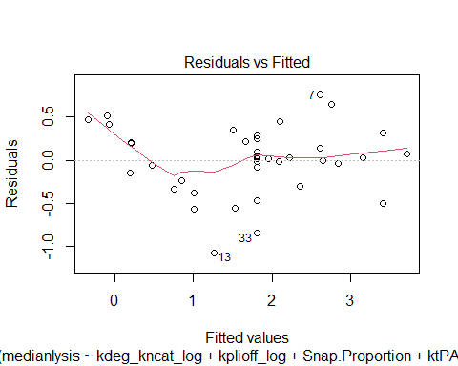
Interpretation of Individual Coefficients
The individual coefficient estimates and their significance tests tell us which predictors have statistically significant relationships with the response variable. A significant coefficient (typically p < 0.05) suggests that the corresponding variable has a meaningful association with median lysis time after accounting for all other variables in the model. The sign of the coefficient indicates the direction of the relationship - positive coefficients suggest that increases in the predictor are associated with increases in the response (or decreases in median lysis time, since we’re modeling the reciprocal), while negative coefficients suggest the opposite relationship.
The Best Adjusted R Squared that I can get is from a 6 predictors model
##Residual Analysis
# Constant variance check plot(best_model, 1)

Slide 20
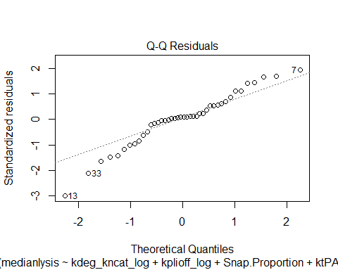
# Normality check plot(best_model, 2)

Slide 21
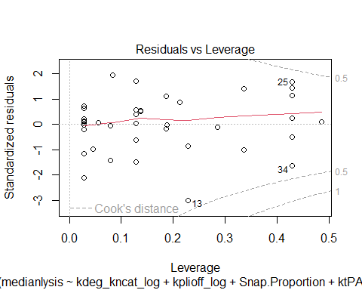
#Outlier check rstd <- rstandard(best_model) which(abs(rstd)>3)
## 13 ## 13
# High Leverage h <- hatvalues(best_model) # cut-off value would be: (2(k+1))/n = (2*(6+1))/42 = 14/42 = 0.3333 which(h > 0.3333)
## 5 14 17 22 25 34 37 38 42 ## 5 14 17 22 25 34 37 38 42
# influential Observations ckd <- cooks.distance(best_model) which(ckd > 0.5)
## named integer(0)
which(ckd > 1)
## named integer(0)
plot(best_model, 5)

Slide 22
Figure 5: Residual diagnostic plots. These plots assess whether the model assumptions are met and identify potential problematic observations.

Slide 23
Residual Analysis Summary
Constant Variance: The residuals vs fitted plot shows a wavy pattern and non-constant spread (wider at extremes, narrower in the middle), indicating mild heteroscedasticity.
Normality: The Q-Q plot shows an S-shape with deviations in both tails (observations 13, 33 in lower tail; 7 in upper tail), suggesting heavier tails than normal.
Outliers: Observation 13 has a standardized residual < -3.
High Leverage: Nine observations (5, 14, 17, 22, 25, 34, 37, 38, 42) have high leverage.
Influence: No observations exceed Cook’s distance thresholds of 0.5 or 1.0, though observations 34 and 25 are near the 0.5 contour and may have some influence.

Slide 24
Discussion

Slide 25
Main Findings and Concluding Remarks
This analysis successfully developed a predictive model for fibrinolysis rates, achieving an adjusted R-squared of 0.8501 (85.01%) with six predictors. This represents a dramatic improvement from the original model, which had a negative adjusted R-squared (-0.2059) and was statistically insignificant (p = 0.989). The transformation approach proved essential: log transformations of the kinetic parameters addressed extreme right skewness, while the reciprocal transformation of the response variable (suggested by Box-Cox analysis) was crucial for achieving both statistical significance and high explanatory power.
The final model identifies six predictors: five highly significant ones—the degradation and catalytic rate constant (kdeg_kncat_log), plasminogen dissociation rate (kplioff_log), snap proportion (negative relationship), tPA binding rate (ktPAon_log), and dissociation constant for tPA without plasminogen (KdtPAnoplg_log)—and one that is not statistically significant (kplgon_log, p = 0.259). Interestingly, removing three variables from the full model (KdtPAyesplg_log, KdPLGnicked_log, KdPLGintact_log) actually improved the adjusted R-squared from 0.8375 to 0.8501, indicating these variables added noise rather than meaningful information.
The most important finding is that fibrinolysis rates depend on multiple kinetic constants and binding affinities working together, rather than any single parameter. These variables represent different aspects of the complex biochemical network involved in clot dissolution. From a practical standpoint, this model could be useful for predicting fibrinolysis outcomes in experimental settings, with the 85% variance explained providing strong predictive capability.

Slide 26
Limitations of the Analysis
I should acknowledge several limitations.
First, the sample size of 42 observations is relatively small for a model with 6 predictors. While sufficient for this analysis, a larger sample would provide more stable coefficient estimates and greater statistical significance.
Second, despite explaining 85% of the variance, 15% remains unexplained. I am actually satisfied with the 85% of variance being explained, especially for complex biological data like this. However, the remaining 15% might be explained by adding more observations to the data set.
Third, residual analysis revealed violations of some regression assumptions. The residuals vs fitted plot shows mild heteroscedasticity (non-constant variance), and the Q-Q plot shows an S-shape with heavier tails than normal. While these violations don’t necessarily invalidate the model, they suggest that standard errors and p-values should be interpreted with some caution. The presence of one outlier (observation 13) and nine high leverage points also suggests some unusual cases in the data, though no observations exceed Cook’s distance thresholds, indicating no highly influential points.
Fourth, model selection involved multiple steps (forward selection, all-possible regressions), and different criteria suggested different optimal models. BIC favored a 5-variable model, while adjusted R-squared favored a 6-variable model. The choice to prioritize adjusted R-squared for prediction purposes highlights the subjective nature of model selection.
Finally, this analysis is correlational and observational. We cannot establish causal relationships, and the associations could be confounded by unmeasured variables or reflect correlations rather than direct causal effects.

Slide 27
What Would Be Done Differently
If redoing this project, several improvements could be made:
First, I would collect a larger sample size (ideally 100-150 observations) to provide more statistical power and allow for proper train-test validation (Cross Validation), which would give a more realistic assessment of predictive performance on unseen data.
Second, I might also explore robust regression methods that are less sensitive to outliers.
Third, I would consider alternative modeling approaches. Given the mild heteroscedasticity, weighted least squares regression might be appropriate. If nonlinear relationships are suspected, polynomial terms or interaction effects could be explored. Machine learning approaches like random forests could provide complementary insights, though with reduced interpretability.
Fourth, I would explore collecting additional variables that might be relevant to fibrinolysis but weren’t included in the original dataset.
Finally, I would conduct a more thorough sensitivity analysis to understand how robust the conclusions are to different modeling choices, transformations, and handling of outliers.

Slide 28
Future Research Directions
Several research directions emerged from this analysis. First, expanding the dataset to include more observations and potentially more variables would allow for more sophisticated modeling and more reliable conclusions. This could include additional kinetic parameters, environmental factors (like temperature, pH, or ion concentrations), or characteristics of the clot itself.
Second, investigating nonlinear relationships and potential interactions between variables could reveal more complex patterns. For instance, the effect of one kinetic constant might depend on the value of another, suggesting that interaction terms could improve the model. Polynomial terms or spline functions could capture curvilinear relationships that the linear model misses.
Third, exploring the biological mechanisms underlying the statistical associations could provide deeper insights. Understanding why certain parameters are predictive could lead to testable hypotheses about the fibrinolysis process and potentially identify new therapeutic targets.
Fourth, developing more sophisticated models that account for the heteroscedasticity and other assumption violations could improve both prediction accuracy and the reliability of statistical inferences. This might involve generalized least squares, robust regression methods, or Bayesian approaches.
Finally, translating these statistical findings into practical applications could involve developing predictive tools for clinical or pharmaceutical research. If the model can reliably predict fibrinolysis rates, it could be used to screen potential therapeutic compounds or optimize experimental conditions without requiring extensive laboratory work.
In conclusion, while this analysis has limitations, it provides a solid foundation for understanding the relationships between biochemical parameters and fibrinolysis rates. The transformation approach and model selection process successfully improved the model from statistically insignificant to explaining 85% of the variance. The identified predictors represent a starting point for further investigation, and the methodological approaches developed here could be refined and extended in future work.
# A Good Prediction that fills hope # Observation 20 values from the CSV: # Snap.Proportion: 0.6667 # ktPAon: 0.1 # kplioff: 57.6 # kplgon: 0.1 # KdtPAnoplg: 0.36 # kdeg.and.kncat: 5 # Actual medianlysis: 0.5276 new_data <- data.frame( kdeg_kncat_log = log(5), kplioff_log = log(57.6), Snap.Proportion = 0.6667, ktPAon_log = log(0.1), KdtPAnoplg_log = log(0.36), kplgon_log = log(0.1) ) predicted_reciprocal<- predict(best_model, newdata = new_data) predicted_medianlysis<- 1 / predicted_reciprocal cat("Predicted medianlysis:", predicted_medianlysis, "\n")
## Predicted medianlysis: 0.5537213
cat("Actual medianlysis: 0.5276\n")
## Actual medianlysis: 0.5276
cat("Difference:", abs(0.5276- predicted_medianlysis), "\n")
## Difference: 0.02612132
# A bad prediction that destroys Confidence # Observation 25 values from the CSV: # Snap.Proportion: 0.6667 # ktPAon: 0.1 # kplioff: 57.6 # kplgon: 0.1 # KdtPAnoplg: 0.036 # kdeg.and.kncat: 5 # Actual medianlysis: 1.606 new_data <- data.frame( kdeg_kncat_log = log(5), kplioff_log = log(57.6), Snap.Proportion = 0.6667, ktPAon_log = log(0.1), KdtPAnoplg_log = log(0.036), kplgon_log = log(0.1) ) predicted_reciprocal<- predict(best_model, newdata = new_data) predicted_medianlysis<- 1 / predicted_reciprocal cat("Predicted medianlysis:", predicted_medianlysis, "\n")
## Predicted medianlysis: 1.168612
cat("Actual medianlysis: 1.606\n")
## Actual medianlysis: 1.606
cat("Difference:", abs(1.606- predicted_medianlysis), "\n")
## Difference: 0.4373876

